Slide 1


Real Estate Analysis
Table of contents
01
02
Business Understanding
Generating Questions
04
05
Cleaning Data
Analyzing Data
By: Mahmoud Ahmed Shimy
03
Gathering & Understanding Data
06
Conclusions

Slide 2

Real Estate Analysis
DREAMHOUSE
Table of contents
01
02
03
Business Understanding
Generating Questions
Gathering & Understanding Data
04
05
06
Cleaning Data
Analyzing Data
Conclusions
By: Mahmoud Ahmed Shimy

Slide 3


Before we begin…
DREAMHOUSE
Table of contents
01
Business Understanding
02
We need to know what we want from this project.
Simply the objective of this analysis is:
Identify key insights to help stakeholders make informed decisions in real estate.
A deeper understanding of price determinants and their relative impact.
Need insights on where to buy/sell and expected return on investment
Business Understanding
Generating Questions
04
05
Cleaning Data
Analyzing Data
03
Gathering & Understanding Data
06
Conclusions

Slide 4

Before we begin…
01
02
Generating Questions
We need to know what we want from this project.
Simply the objective of this analysis is:
Identify key insights to help stakeholders make informed decisions in real estate.
A deeper understanding of price determinants and their relative impact.
Need insights on where to buy/sell and expected return on investment
Business Understanding

Slide 5
Before we begin…
02
Generating Questions
We need to know what we want from this project.
Simply the objective of this analysis is:
Identify key insights to help stakeholders make informed decisions in real estate.
A deeper understanding of price determinants and their relative impact.
Need insights on where to buy/sell and expected return on investment
How does the number of floors influence the total price?
How do house prices differ between those sold with cash, installments, or both?
7
Is there a trend between payment options and house types.
5
What is the average price of houses for each house type?
10
1
Which city has the highest average house prices?
6
Are installment options more common for more expensive or cheaper houses?
2
What percentage of the listed houses are furnished? what is it affect on price?
9
Is there a strong correlation between the area of the house and its price?
3
How does the number of bedrooms & Bathrooms affect house prices?
4
8
Which city offers the largest area for the same price range?

Slide 6

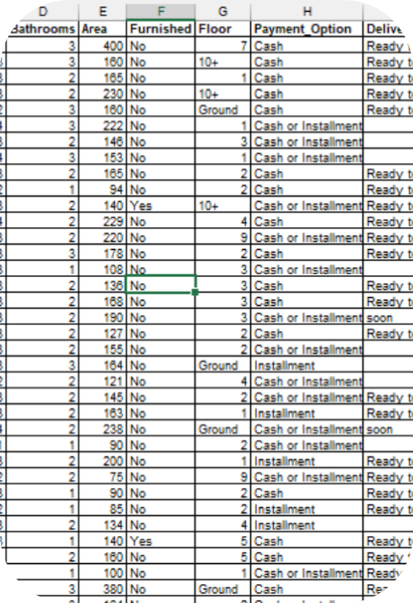
An Example of 10 Questions To be Answered
02
Generating Questions
03
1
What is the average price of houses for each house type?
6
Are installment options more common for more expensive or cheaper houses?
Gathering & Understanding Data
2
Which city has the highest average house prices?
7
How does the number of floors influence the total price?
3
What percentage of the listed houses are furnished? what is it affect on price?
8
Which city offers the largest area for the same price range?
“Egypt_Houses_price” Dataset
This data is collected by People not company from OLx.com
4
How does the number of bedrooms & Bathrooms affect house prices?
9
Is there a strong correlation between the area of the house and its price?
5
How do house prices differ between those sold with cash, installments, or both?
10
Is there a trend between payment options and house types.

Slide 7
Understanding Data Columns
03
Gathering & Understanding Data
“Egypt_Houses_price” Dataset
This data is collected by People not company from OLx.com
12 cols
27,361 rows
Column | Description | Column | Description
1. Type | The type of property (apartment, villa,…) | 7. Floor | In what floor the property is?
2. Price | The price of property | 8. Compound | In what Compound the property is?
3. Bedrooms | Number of bedrooms | 9. Payment_Option | Available Payment methods (cash or installment)
4. Bathrooms | Number of bathrooms | 10. Delivery_Date | When will the property will be ready to move.
5. Area | The Area of the property by m² | 11. Delivery_Term | What is the condition of the property (Finished, Semi,...)
6. Furnished | Is the property Furnished or not | 12. City | The property in which city (Nasr city, Tagamo3,…)
How does the number of floors influence the total price?
How do house prices differ between those sold with cash, installments, or both?
7
Is there a trend between payment options and house types.
5
What is the average price of houses for each house type?
10
1
Which city has the highest average house prices?
6
Are installment options more common for more expensive or cheaper houses?
2
What percentage of the listed houses are furnished? what is it affect on price?
9
Is there a strong correlation between the area of the house and its price?
3
How does the number of bedrooms & Bathrooms affect house prices?
4
8
Which city offers the largest area for the same price range?

Slide 8


Understanding Data Columns
03
04
Column | Description | Column | Description
1. Type | The type of property (apartment, villa,…) | 7. Floor | In what floor the property is?
2. Price | The price of property | 8. Compound | In what Compound the property is?
3. Bedrooms | Number of bedrooms | 9. Payment_Option | Available Payment methods (cash or installment)
4. Bathrooms | Number of bathrooms | 10. Delivery_Date | When will the property will be ready to move.
5. Area | The Area of the property by m² | 11. Delivery_Term | What is the condition of the property (Finished, Semi,...)
6. Furnished | Is the property Furnished or not | 12. City | The property in which city (Nasr city, Tagamo3,…)
Gathering & Understanding Data
Cleaning Data
“Egypt_Houses_price” Dataset
This data is collected by People not company from OLx.com

Slide 9
Understanding Data Columns
04
Cleaning Data
Column | Description | Column | Description
1. Type | The type of property (apartment, villa,…) | 7. Floor | In what floor the property is?
2. Price | The price of property | 8. Compound | In what Compound the property is?
3. Bedrooms | Number of bedrooms | 9. Payment_Option | Available Payment methods (cash or installment)
4. Bathrooms | Number of bathrooms | 10. Delivery_Date | When will the property will be ready to move.
5. Area | The Area of the property by m² | 11. Delivery_Term | What is the condition of the property (Finished, Semi,...)
6. Furnished | Is the property Furnished or not | 12. City | The property in which city (Nasr city, Tagamo3,…)
Removing Nulls
Feature Engineering
Unfortunately, the data was having a big number of null values. The remaining rows are about 9.8K observation and it’s more than enough for our analysis
We did Dimensionality Reduction and selected the useful columns and dropped the rest like “Compound” due to its big number of null values.
We added a “Expensive” col. that tell us whether it’s above 3M EGP or not
Removing Duplicates
Identify and drop exact or near duplicates while ensuring no critical data is lost.
The data had no duplicates.

Slide 10


Cleaning Data
04
05
Analyzing Data
Cleaning Data
Removing Nulls
Removing Duplicates
Feature Engineering
Unfortunately, the data was having a big number of null values. The remaining rows are about 9.8K observation and it’s more than enough for our analysis
Identify and drop exact or near duplicates while ensuring no critical data is lost.
The data had no duplicates.
We did Dimensionality Reduction and selected the useful columns and dropped the rest like “Compound” due to its big number of null values.
We added a “Expensive” col. that tell us whether it’s above 3M EGP or not

Slide 11
1
05
What is the average price of houses for each house type?
Analyzing Data
Removing Nulls
Feature Engineering
Unfortunately, the data was having a big number of null values. The remaining rows are about 9.8K observation and it’s more than enough for our analysis
We did Dimensionality Reduction and selected the useful columns and dropped the rest like “Compound” due to its big number of null values.
We added a “Expensive” col. that tell us whether it’s above 3M EGP or not
Removing Duplicates
Identify and drop exact or near duplicates while ensuring no critical data is lost.
The data had no duplicates.

Slide 12
What is the average price of houses for each house type?
1
2
05
Which city has the highest average house prices?
Analyzing Data

Slide 13
Which city has the highest average house prices?
3
3
What percentage of the listed houses are furnished? what is it affect on price?
What percentage of the listed houses are furnished? what is it affect on price?
1
2
What is the average price of houses for each house type?
Not Furnished
Furnished
The average price for not furnished houses is:
2,686,718 ج.م.‏
The average price for furnished houses is:
3,644,284 ج.م

Slide 14
2
3
Which city has the highest average house prices?
What percentage of the listed houses are furnished? what is it affect on price?
Yes, It affect; The Furnished houses are generaly more expensive.
Not Furnished
Furnished
The average price for not furnished houses is:
2,686,718 ج.م.‏
The average price for furnished houses is:
3,644,284 ج.م

Slide 15
How does the number of bedrooms affect house prices?
3
What percentage of the listed houses are furnished? what is it affect on price?
4
5
How does the number of Bathrooms affect house prices?
Correlation
5.3%
95.7%
Positive
Negative
Not Furnished
Furnished
The average price for not furnished houses is:
2,686,718 ج.م.‏
The average price for furnished houses is:
3,644,284 ج.م

Slide 16
How does the number of Bathrooms affect house prices?
5
4
6
How do house prices differ between those sold with different Payment methods?
How does the number of bedrooms affect house prices?
Correlation
3.2%
96.8%
Positive
Negative

Slide 17
How do house prices differ between those sold with different Payment methods?
5
7
How does the number of Bathrooms affect house prices?
6
Do installment options more common for more expensive?
Cash
Avg Prices: 3,073,730 ج.م.
Both
Avg Prices: 2,395,032 ج.م.‏
Installment
Avg Prices: 2,954,517 ج.م.‏

Slide 18
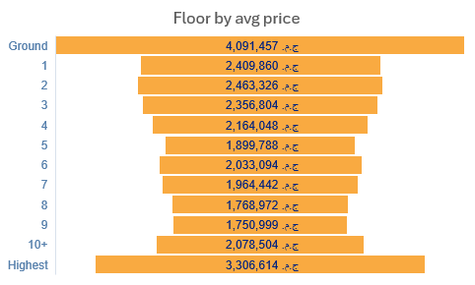
Do installment options more common for more expensive?
7
6
How do house prices differ between those sold with different Payment methods?
8
How does the number of floors influence the price?
According to Data the installment options more common for the cheaper houses.

Slide 19
How does the number of floors influence the price?
8
7
Which city offers the largest area for the same price range?
Do installment options more common for more expensive?

Slide 20
Which city offers the largest area for the same price range?
How does the number of floors influence the price?
9
Is there a strong correlation between the area of the house and its price?

Slide 21
Is there a strong correlation between the area of the house and its price?
Which city offers the largest area for the same price range?
10
The average price for each house type and Payment method whether it's furnished or not?

Slide 22
The average price for each house type and Payment method whether it's furnished or not?
Is there a strong correlation between the area of the house and its price?
11
Is there a trend between payment options and house types?

Slide 23

Is there a trend between payment options and house types?
06
Conclusions
The average price for each house type and Payment method whether it's furnished or not?
12

Slide 24
06
26,385,504,893
Conclusions

Slide 25
26,385,504,893
Sum of Prices listed on the website

Slide 26
9,408
Ground floor has the biggest price average with about 4M EGP and the 9th is the least with 1.75M EGP.
06
Dawahy in portsaid has the lowest meter price with 1.3K EGP and El Gouna is the most expensive with 56K EGP per meter.
07
Property Price is correlated positively with the Area with 51%.
08
Town house has the biggest chance of installment options with 84% against Standalone villa with 41%.
09
Number of houses
01
Standalone Villa has the biggest average price with 13.5M EGP and Studios is the least with 1.5M EGP.
02
North coast has the biggest average prices with 4.6M EGP.
03
The furnished houses are generally more expensive with about 27% than not.
04
No. of bedrooms and bathrooms is Highly positive correlated with the price with more than 95%.
05
installment options are more commonly in cheaper houses with about 55% compared with 50% in the expensive.

Slide 27
Conclusions
01
Standalone Villa has the biggest average price with 13.5M EGP and Studios is the least with 1.5M EGP.
Ground floor has the biggest price average with about 4M EGP and the 9th is the least with 1.75M EGP.
06
02
North coast has the biggest average prices with 4.6M EGP.
Dawahy in portsaid has the lowest meter price with 1.3K EGP and El Gouna is the most expensive with 56K EGP per meter.
07
Thanks!
03
The furnished houses are generally more expensive with about 27% than not.
Property Price is correlated positively with the Area with 51%.
08
04
No. of bedrooms and bathrooms is Highly positive correlated with the price with more than 95%.
Town house has the biggest chance of installment options with 84% against Standalone villa with 41%.
09
05
installment options are more commonly in cheaper houses with about 55% compared with 50% in the expensive.
Do you have any questions?
Mahmoud Shimy@

Slide 28

Thanks!
Conclusions
Do you have any questions?
Mahmoud Shimy@
01
Standalone Villa has the biggest average price with 13.5M EGP and Studios is the least with 1.5M EGP.
Ground floor has the biggest price average with about 4M EGP and the 9th is the least with 1.75M EGP.
06
02
North coast has the biggest average prices with 4.6M EGP.
Dawahy in portsaid has the lowest meter price with 1.3K EGP and El Gouna is the most expensive with 56K EGP per meter.
07
03
The furnished houses are generally more expensive with about 27% than not.
Property Price is correlated positively with the Area with 51%.
08
04
No. of bedrooms and bathrooms is Highly positive correlated with the price with more than 95%.
Town house has the biggest chance of installment options with 84% against Standalone villa with 41%.
09
05
installment options are more commonly in cheaper houses with about 55% compared with 50% in the expensive.

